Slide 1

Crop Recommendation System Using AI and Chatbot
This presentation will discuss a cutting-edge crop recommendation system designed to assist farmers in making informed decisions, ultimately leading to increased yields and sustainable practices.
Madhumeeta Omprakash
Nithya J
Namrata
Varshitha M L

Slide 2
Problem Statement:
Farmers often struggle to select the right crops for specific soil and environmental conditions, leading to poor crop yields and inefficiencies.
Solution:
The Crop Recommendation System uses AI to recommend the most suitable crops based on various environmental and soil factors.
The system incorporates a Chatbot, providing personalized recommendations and explanations to users based on their inputs.
Key Benefits:
Helps farmers choose the best crops for optimal yields.
Provides clear, AI-generated explanations for the recommendations.
User-friendly interface for easy interaction with the system.

Slide 3
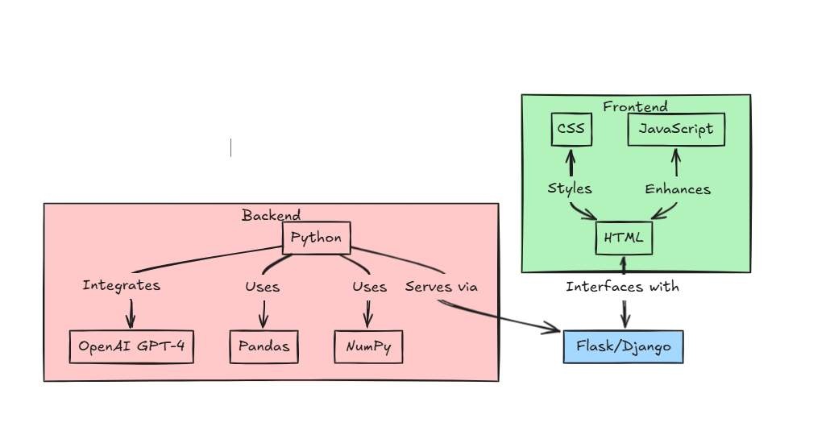
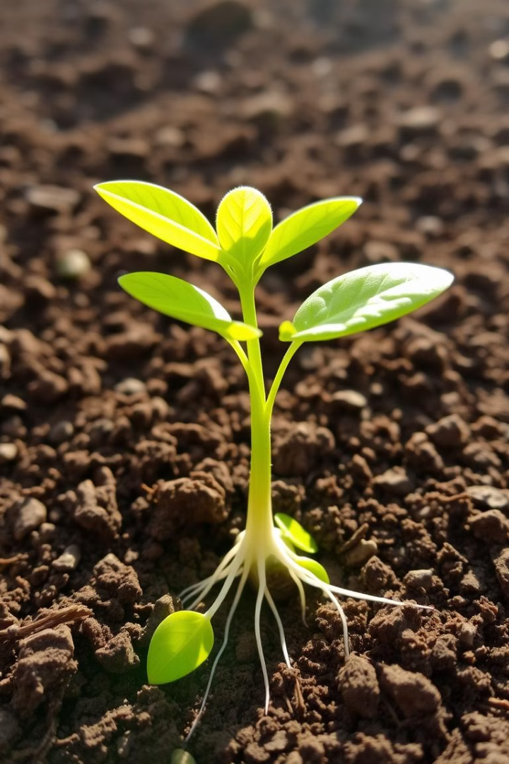
Backend:
Python: Used for developing the recommendation logic and integrating the AI chatbot.
OpenAI: GPT-4 model used to generate detailed explanations for crop recommendations.
Pandas & NumPy: Data manipulation and calculations, such as distance metrics, for crop recommendation.
Frontend:
HTML, CSS, JavaScript: For building a clean and interactive user interface.
Flask: Backend framework to serve the application.

Slide 4
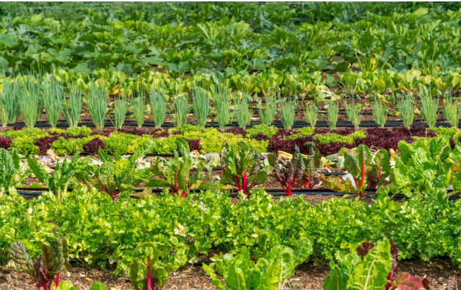

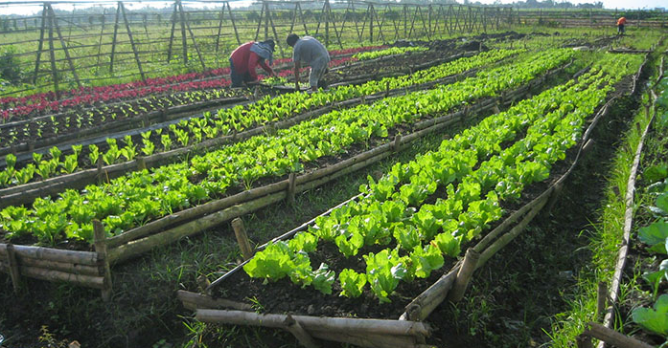


Problem Statement: Farmers struggle to choose the right crops for specific soil and environmental conditions
Limited Access to Data
Farmers often lack access to comprehensive and readily available information on soil properties, climate patterns, and crop suitability.
Lack of Expertise
Not all farmers possess the necessary expertise to accurately assess soil conditions, climate risks, and crop requirements for optimal yields.
Time Constraints
Farmers have limited time and resources to research and analyze data, making it difficult to make informed decisions regarding crop selection.

Slide 5

How AI and Chatbots Can Help
AI-Powered Analysis
Chatbot Interface
AI algorithms can analyze vast datasets, including soil data, climate data, and historical crop performance to provide accurate and tailored recommendations.
A user-friendly chatbot interface allows farmers to easily interact with the system, input their specific needs, and receive personalized recommendations.
Real-Time Information
Farmers can access real-time information on weather forecasts, soil conditions, and market trends through the chatbot, making informed decisions based on current conditions.

Slide 6
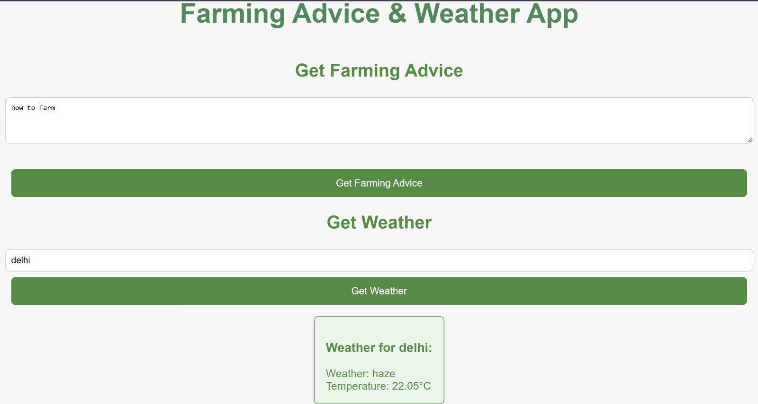

Slide 7
